Slide 1
Predicting Lung Cancer Incidence from Health and Behavioral Risk Factors
By: Brice Howe and Valyn Grebe

Slide 2
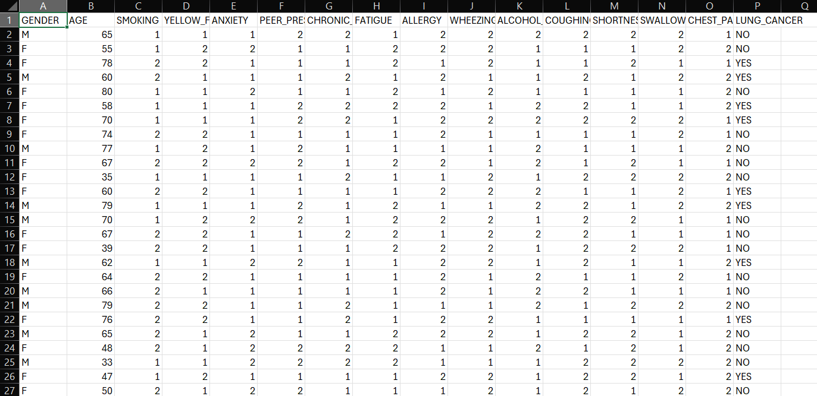
Dataset
Predictor/Response Variables:
Character: Gender (M or F)
Numeric: Age
Binary: Smoking, yellow fingers, anxiety, peer pressure, allergies, fatigue, chronic disease, wheezing, alcohol consumption, coughing, shortness of breath, swallowing difficulty, chest pain
Target/Response Variable:
Lung Cancer (Yes or No)
Sources: Health Data Hub - Poltekkes Kemenkes Semarang

Slide 3
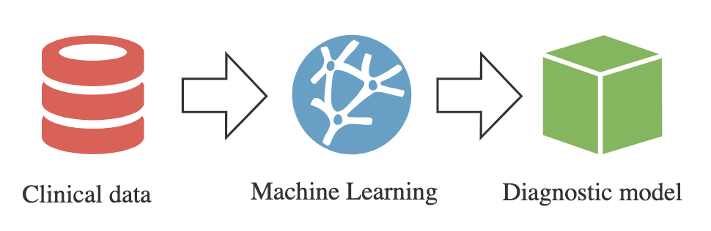
Prior Research
Past research from the CDC and Endalie et al. have found air pollution, coughing of blood, and smoking to have the highest correlation with lung cancer
Possible high correlations in our dataset include coughing and smoking
Previous work from Endalie et al. and Pathan et al. have used many model types, some being decision trees, neural networks, random forests, k-nearest neighbors, etc.

Slide 4
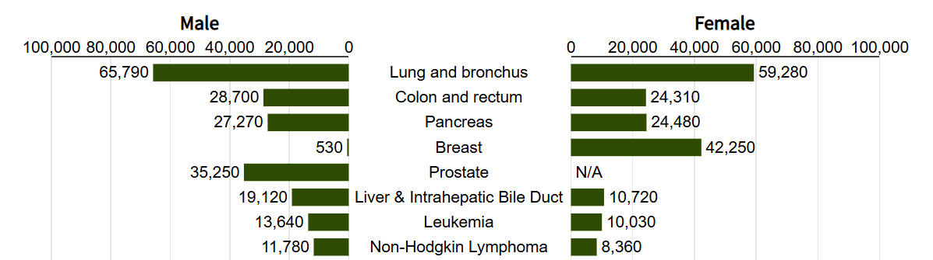
Importance/Motivation
230,000 new patients in the US are diagnosed with lung cancer each year, and 73% of them die within five years of diagnosis
Leading cause of cancer deaths worldwide comprising ~20% of all deaths due to cancer
Second leading cause is colon cancer comprising 9% of cancer deaths
Cancer will cost the global economy over 25 trillion dollars between 2020 and 2050 with lung cancer costing the greatest proportion across all cancer types
Largest costs compared to all other cancers in the United States

Slide 5
Plans for Today
Data Cleaning
Converting NO and YES into 0 and 1
Converting 1 and 2 into 0 and 1
EDA
Assess initial correlation between explanatory variables and the response through a boxplot and histogram for age and bar charts for binary variables
Visualize distribution of lung cancer prevalence using pie chart
Narrow down ML model choice
K-Nearest Means, Random Forest, Decision Trees, Gradient Boosting

Slide 6
Group 1: Hospital Readmission
Mention more about data cleaning
Very cool interactive state plots
Include limitations on data/models

Slide 7
Group 3: Alcohol Consumption
Explained everything very well
The state graphs were a little small
Explain how limitations were accounted

Slide 8
Group 4: Harry Potter
Good recap and explanation of data
Book 1 vs Actual Book 7 plot was missing some blue points → maybe explain these missing points
Include limitations on data/models

Slide 9
Group 5: Medicaid Enrollment
Graphs were insightful and easy to read with good explanations
Try to refrain from using light yellow as a color for the bar graphs
Simple graph, easy to read, good explanations
Like how you went beyond physical conditions
Consolidate some of the explanations of the graphs (slides were a little wordy)

Slide 10
Group 6: Visa Issuances
Title the project
Avoid using yellow as a color for the top 5 countries line plots
Place your graphs/visualizations in a subgroup called Visualization/Data Exploration
Include limitations on data/models
Summarize the background research more concisely
Thought the plots highlighting visa issuances over presidential terms were really impactful

Slide 11
Group 7: Covid Vaccinations
Explain why you used the ANOVA testing as opposed to other methods
Avoid having to switch tabs between the slideshow and your excel data
Include limitations on data/models as well as key takeaways
Liked the presentation theme/aesthetic

Slide 12
Our Feedback
Combine graphs on EDA
Highlight main takeaways (add text)
Explain why we chose each model
More concise in statistical analysis
Clarify the comparison between the models
Explain PCA

